Slide 1
Coursera capstone
IBM Applied Data Science Capstone
Opening a new shopping mall in Kampala Uganda
By Godfrey Obong
March 2019

Slide 2
Business problem
Location of a shopping mall is one of the most important decisions to determine the success or failure of the venture.
Objective: To analyze and select the best location in the city of Kampala, Uganda to open a new shopping mall.
Business question : What is the best location to open up a shopping mall in the city of Kampala by a property developer.

Slide 3
DATA
Data required.
List of suburbs in Kampala city.
Latitudes and longitude coordinates of suburbs.
Venue data particularly that related to shopping malls
Source of data
Wikipedia page for suburbs
https://en.wikipedia.org/wiki/Category:Neighborhoods_of_Kampala
Geocoder package for latitudes and longitudes plus coordinate sites such as
www.latlong.net
Foursquare API for venue data

Slide 4
Methodology
Web scraping Wikipedia and other websites to obtain list of suburbs
Get latitude and longitude coordinates using Geocoder and other websites such as
www.latlong.net
Use Foursquare API to get venue data.
Group data by suburb taking the mean of frequency of occurrence of each venue category.
Filter venue category by shopping mall and average rental charges per suburb.
Perform clustering on data by using K means clustering.
Visualize the clusters in a map using folium.

Slide 5
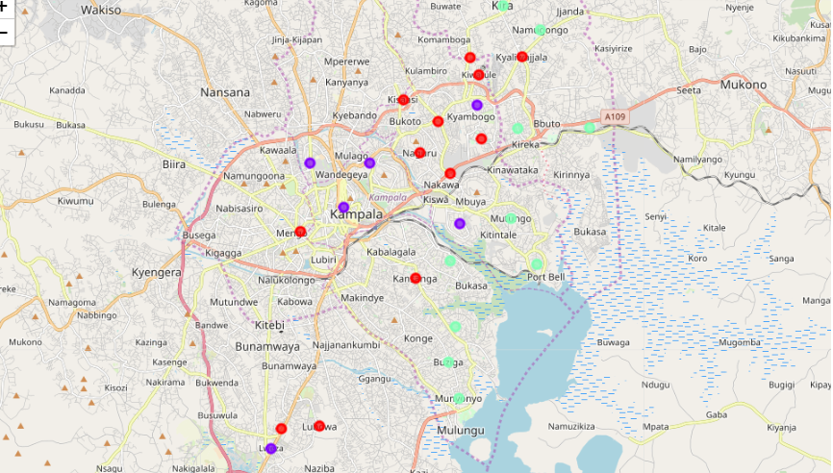
RESULTS
CLUSTERING
Cluster 0(red):Suburbs with high concentration of shopping malls.
Cluster 1(purple):Suburbs with moderate number of shopping malls.
Cluster 2(mint green):Suburbs with no shopping malls within.

Slide 6
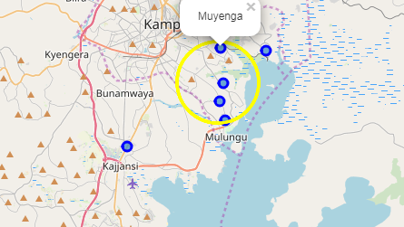
Further analysis
Filtering out the suburbs with already existing shopping mall venues and those with rental charges below 1,000,000 Ugandan shillings left me with 7 suburbs namely Bukoto, Bunga, Buziga, Luzira, Lweza, Munyonyo and Muyenga.

Slide 7
DISCUSSION
Most of the shopping malls are concentrated in the central region of the city.
Highest number in cluster 0 and no shopping mall in cluster 2.
The suburbs in the central region have a higher concentration of shopping malls compared to those on the outskirts.

Slide 8
RECOMMENDATION
Open shopping mall in suburbs found in cluster 2 where there is no competition.
Avoid opening in cluster 0 where there are already a number of shopping malls.
Further analysis indicate the areas of Bunga, Buziga, Muyenga and Munyonyo to be the most ideal considering average rental charges and shopping mall concentration.

Slide 9
CONCLUSION
Answer to business question
The suburbs in cluster 2 are the most ideal to open up a shopping mall in Kampala.
The location within the vicinity of the suburbs of Muyenga, Munyonyo, Bunga and Buziga were found to be the most preferred.
Findings of this project will help the relevant stake holders to capitalize on opportunities on high potential locations while avoiding over crowded areas in their decision to open a new shopping mall in Kampala, Uganda

